Slide 1

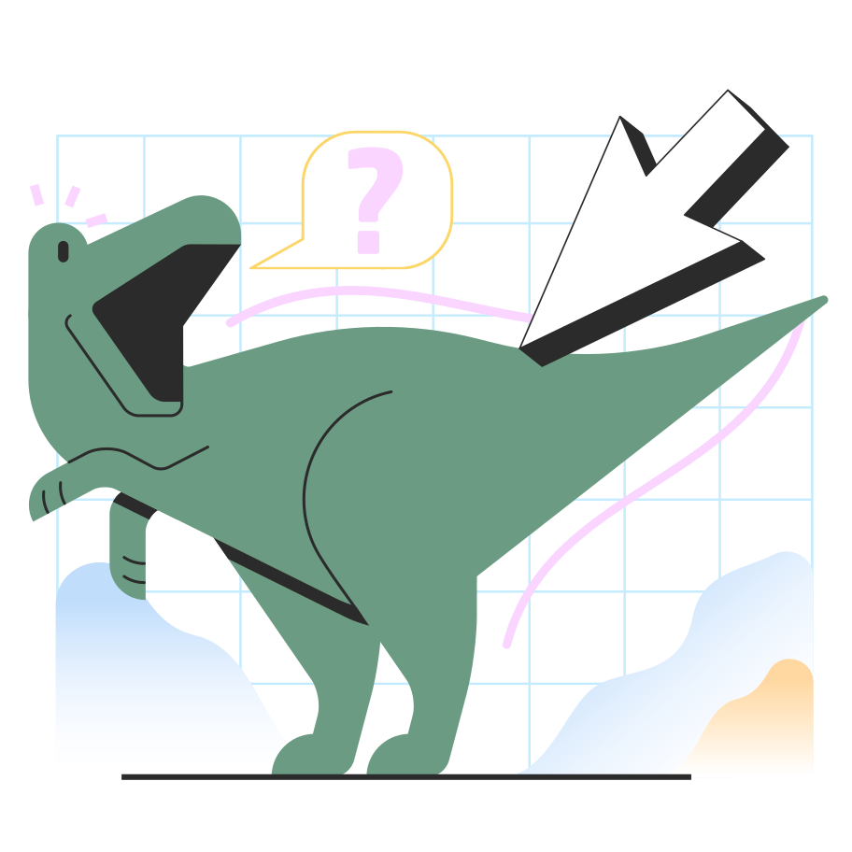
Virtual Kaiju
Capstone 2022

Slide 2
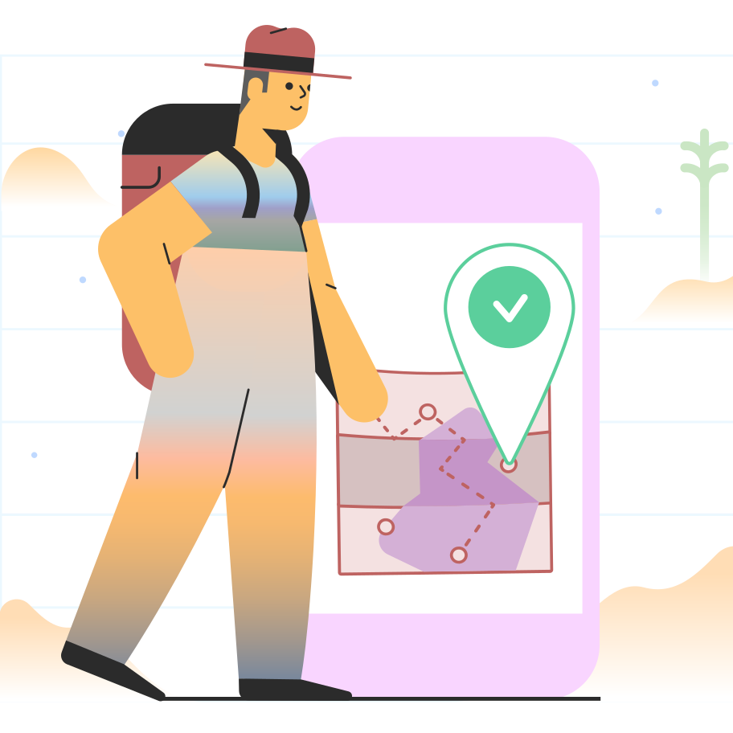
Project Introduction

Slide 3
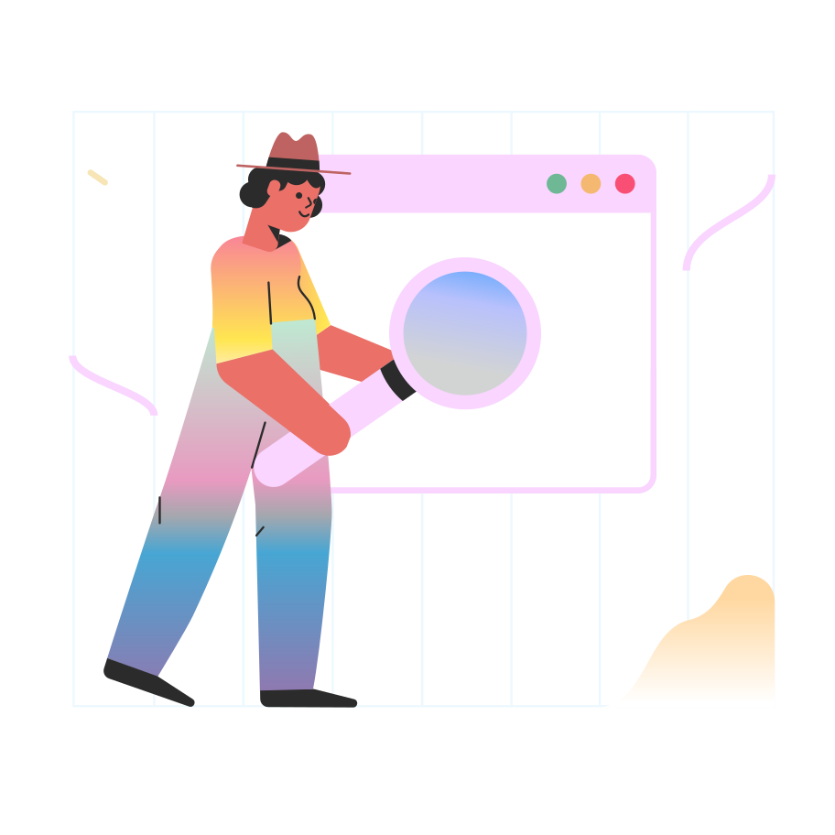
Project Brief
The goal of this project was to build a virtual pet simulator, similar to the Tamagotchi, where a user raises a virtual Kaiju to adulthood. The game would begin with the Kaiju still in its egg, and once it hatched, it would need regular care to reach full maturity. The user could interact with the Kaiju by
feeding it if it was hungry
bathing it if it was dirty (which is represented by a growing number of poops which appear on the screen)
providing medical care if it was sick, which is caused by poor hygiene
disciplining it if it was being fussy
playing with it if it was unhappy
The play component of the game would take the form of mini games for the user. We also aspired to enhance the functionality of the program by allowing users to post their high scores from the mini games on a website to form rankings and leader boards, etc. Our team consisted of 5 members, which allowed us to assign the roles of the project as follows: Rose was the overall project manager; Mark was our Unity dev lead; Josh was the website back-end dev lead; Wiktoria was the database lead; and Cassandra was the UI/UXD lead.
Our project was unofficially broken down into two components: the Unity game, and the website/database. Over the course of the project, all team members worked hard to develop their portions while also dealing with a very heavy load of schoolwork and other obligations. Ultimately, we were able to mostly finish both the Unity component (except the mini games) and the web component, but stopped short at being able to connect the two. Although we were not able to get the project to 100% completion, this experience was all about the journey, not the destination, and we still feel like we have learned a great deal from the experience.

Slide 4

Team Introduction and Contributions

Slide 5
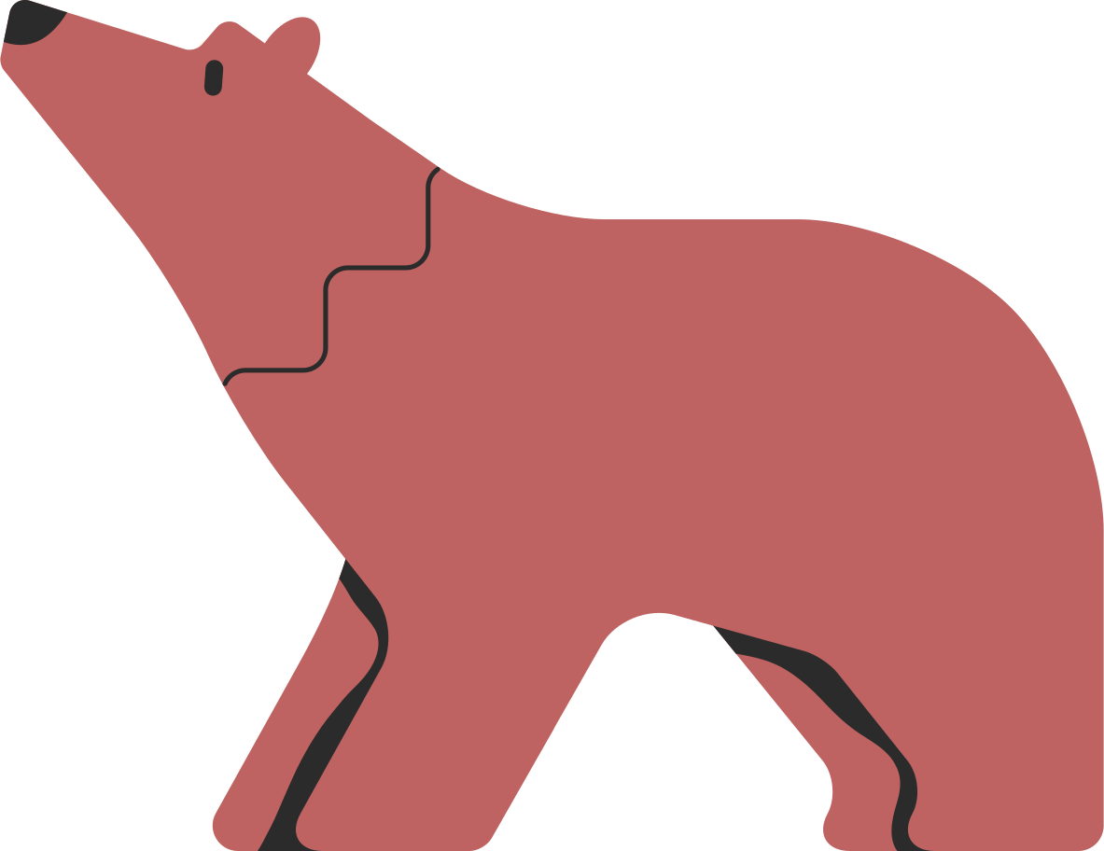
Cassandra
UI/UX Lead
I was responsible for the overall design of the Unity game. I wanted it to still have the feel of an old Tamagatchi where the pet is front and center and the icons for interacting with the pet are aligned around the frame, but I also wanted it to feel more like a desktop game, so I introduced the side menu with the status bars for age, happiness and hunger. As with everyone on our team, I wish I had had more time to dedicate to this project and really making it look as I had envisioned it, but overall, I am happy with the design of the final product.
Because I also wanted to opportunity to contribute to the coding, I helped with the sickness functionality of the pet. In many ways this was the hardest part of the project for me because it was my first time working collaboratively with other coders, and I had to learn how Git branching and pull requests work. There was also a sharp learning curve to using Unity, and I don't feel like I had adequate time to really wrap my head around it, but luckily my team was able to help me get the functionality working!
Primary contributions:
Designing the wireflow
Sourcing visual assets
Finalizing UI of the app

Slide 6
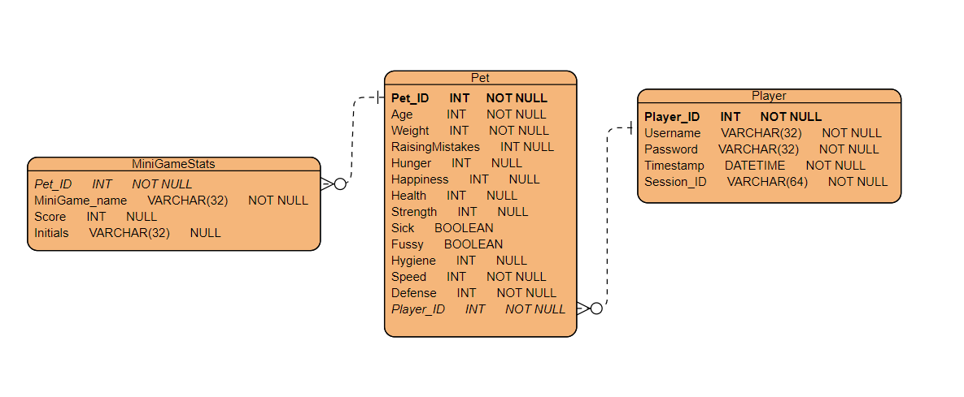
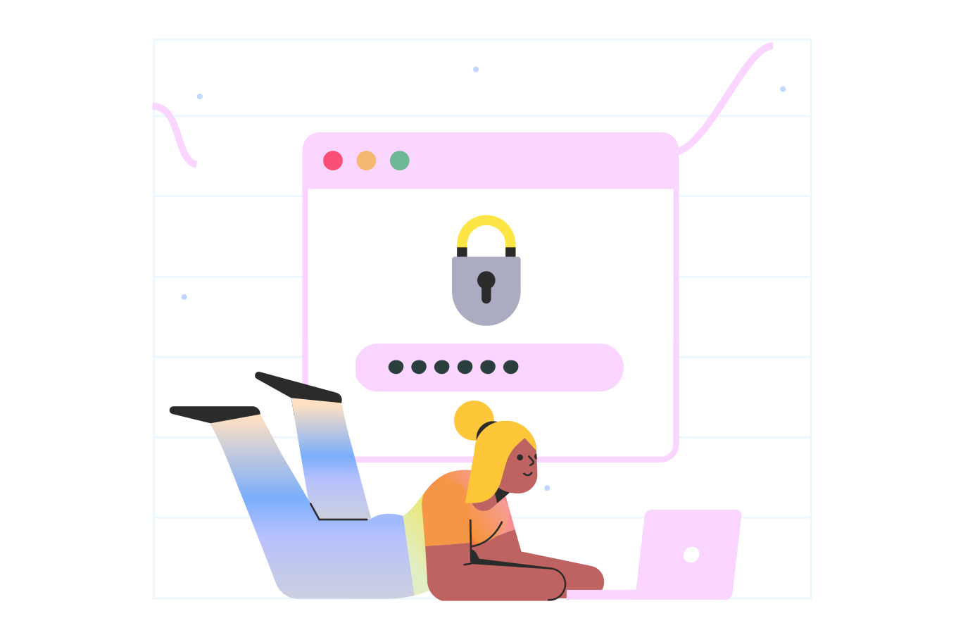
Wiktoria Database Development Lead
I was responsible for the database part of this project. I have designed the Entity Relationship Diagram (ERD) for the game. The idea for the database was to integrate it with unity (what was used to code the game) to keep the stats of the virtual pet and scores from minigames. I added a part for player with the intention to connect it to a website to view this data. However, I was not able to integrate the database with unity as the time was short and needed more in-depth research and testing.
Primary contributions:
Designing Entity Relationship Diagram (ERD)
Creating database
Researching unity and database integration

Slide 7
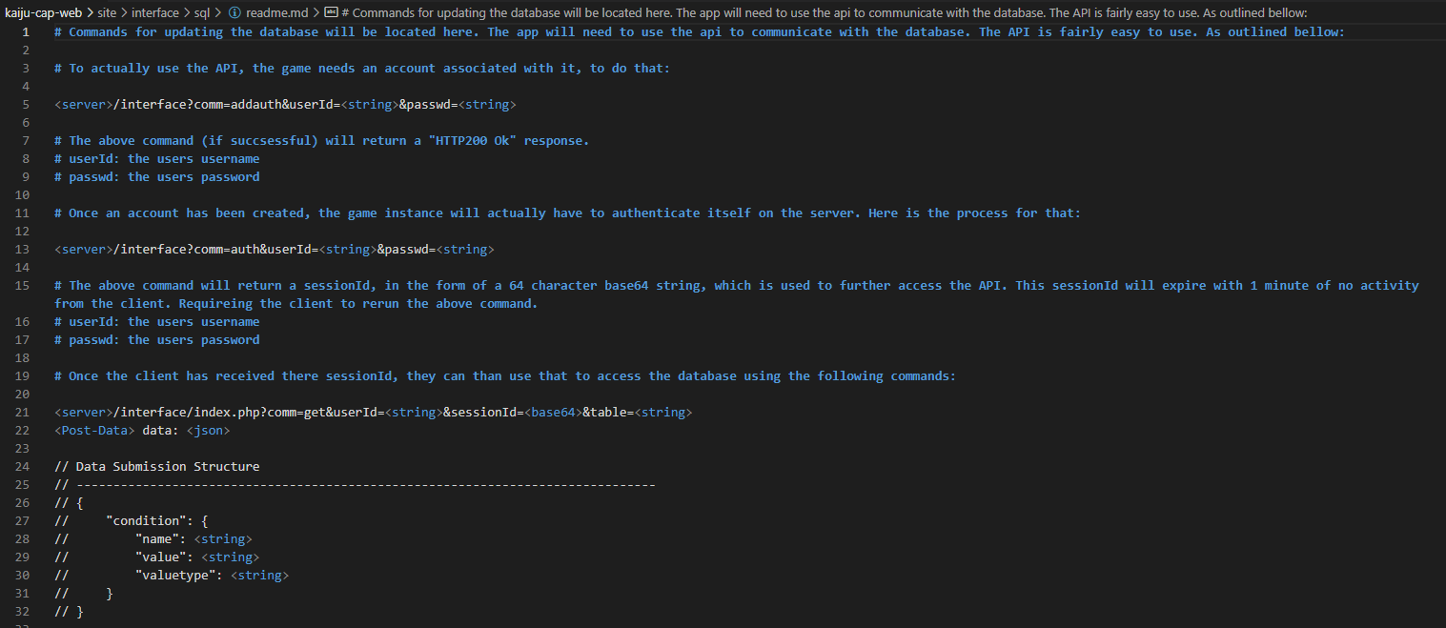
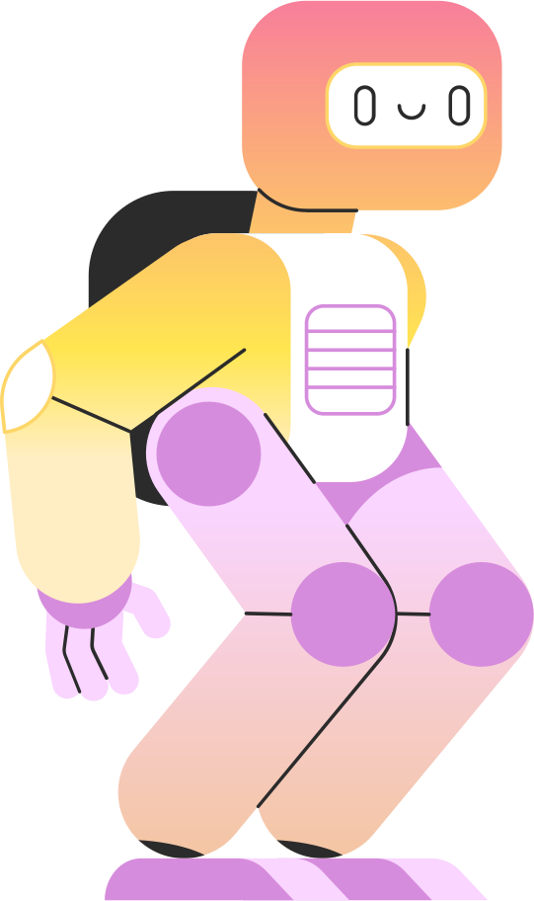
Joshua Jones Web Development Lead Founder of GS (Ghost Spectora & Co.)
My main objective and deliverables had to do with the developing and hosting of the primary web elements of the project. This included setting up the site, database, and development of all multiplayer aspects of the game on the server side.
Created a locally hosted web page to list properties of future virtual pets
Created a database to hold future users
Created web API for authentication handling
Created web API for session handling
Created web API for communication handling between client and database
Created API interface for HTTP and HTTPS use / implementation

Slide 8
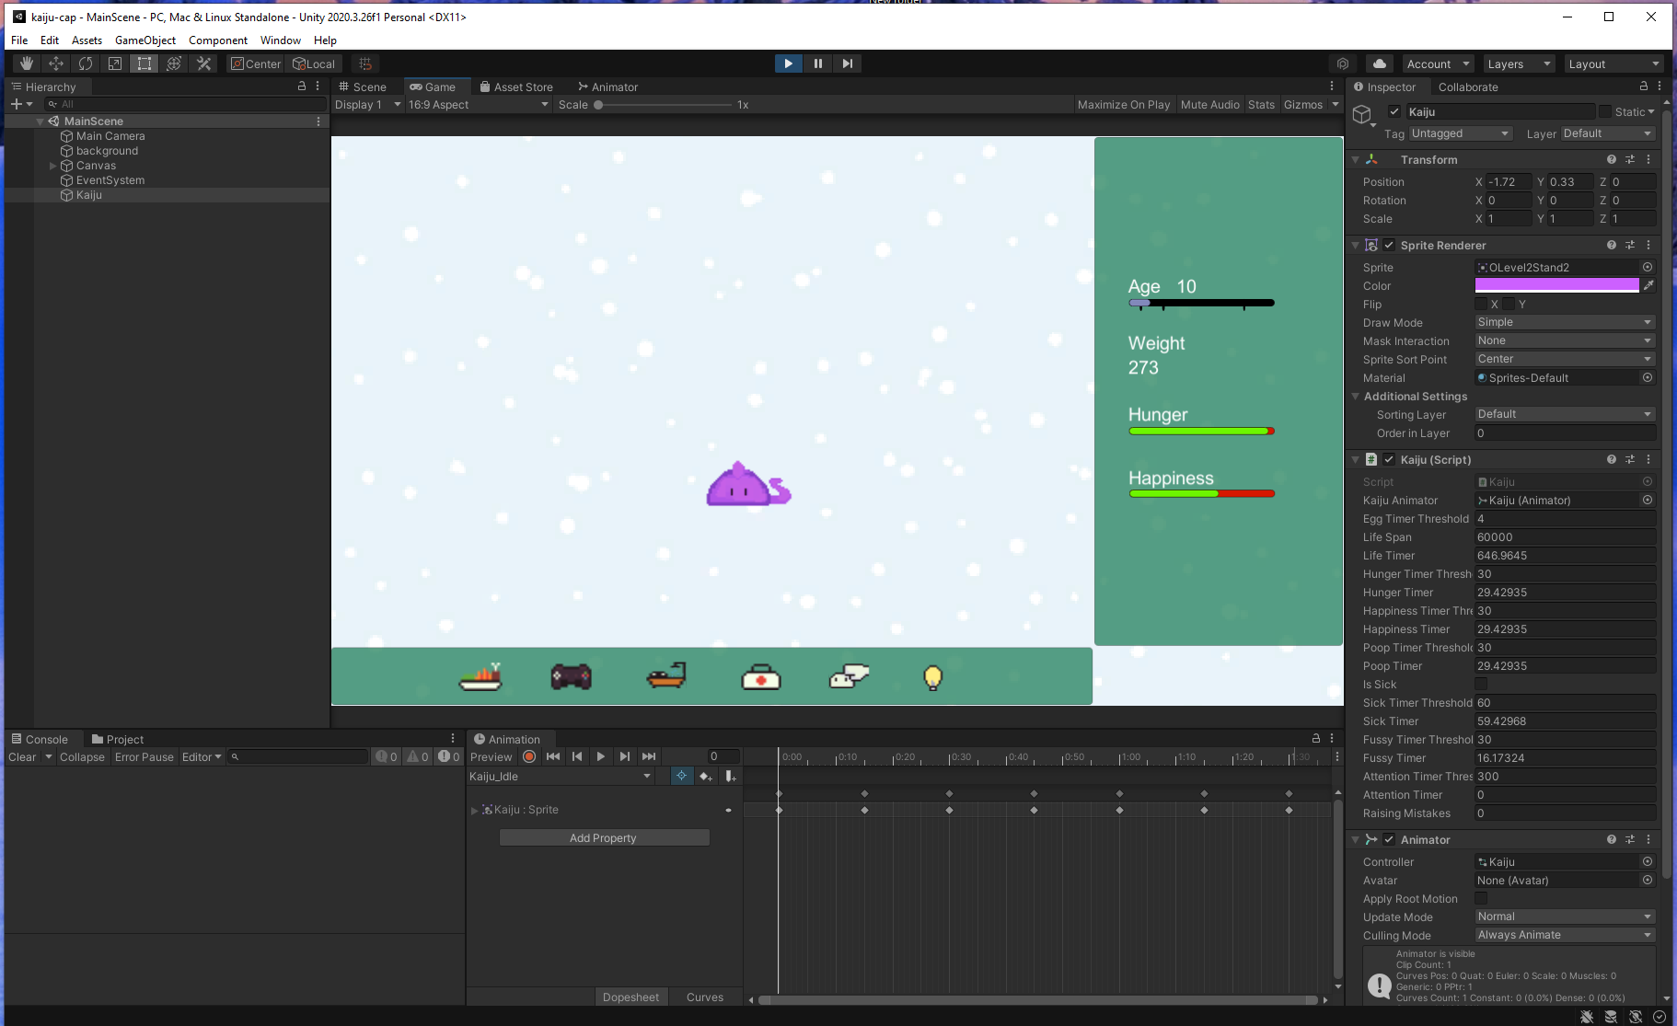
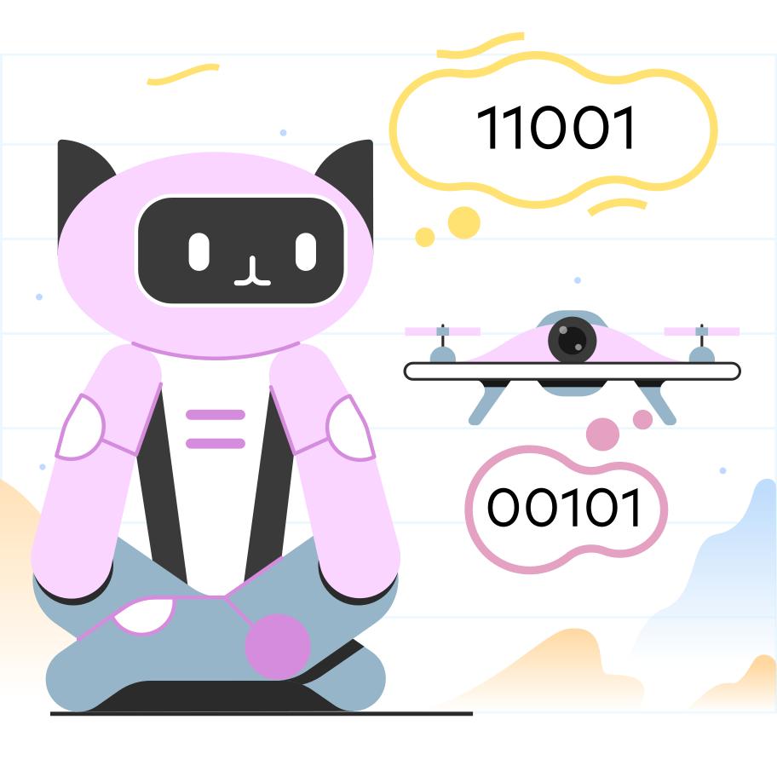
Mark Moulton
Lead Game Designer & Lead Unity Developer
I broke my responsibilities into two main roles:
First during preproduction, I acted as Lead Game Designer. I want to work in the games industry, so it was important to me that we had a cohesive gameplay experience. I wrote a small game design document detailing what stats would be tracked, how the stats interacted with each other, for example poor hygiene increasing chances of becoming sick, and, working with Cassandra our UI/UX Lead, how they would be displayed. It also very briefly touched on the website and database requirements.
When we started production, I switched over to Lead Unity Developer. It was important to me to make it clear that I was the Lead and not the Sole developer, because I didn't want to hog all the fun parts. So, I first provided support for the other devs by providing Unity documentation and resources, I also did a live demo sharing my screen on discord and recording a video for future reference, showing functionality I had preprepared and then walking through the process of adding functionality from scratch with Unity. After all the Unity support was in place, I got to work on the pet care functionality.
Primary contributions:
Designing the pet care gameplay
Coding pet care gameplay functionality
Unity instruction and support

Slide 9
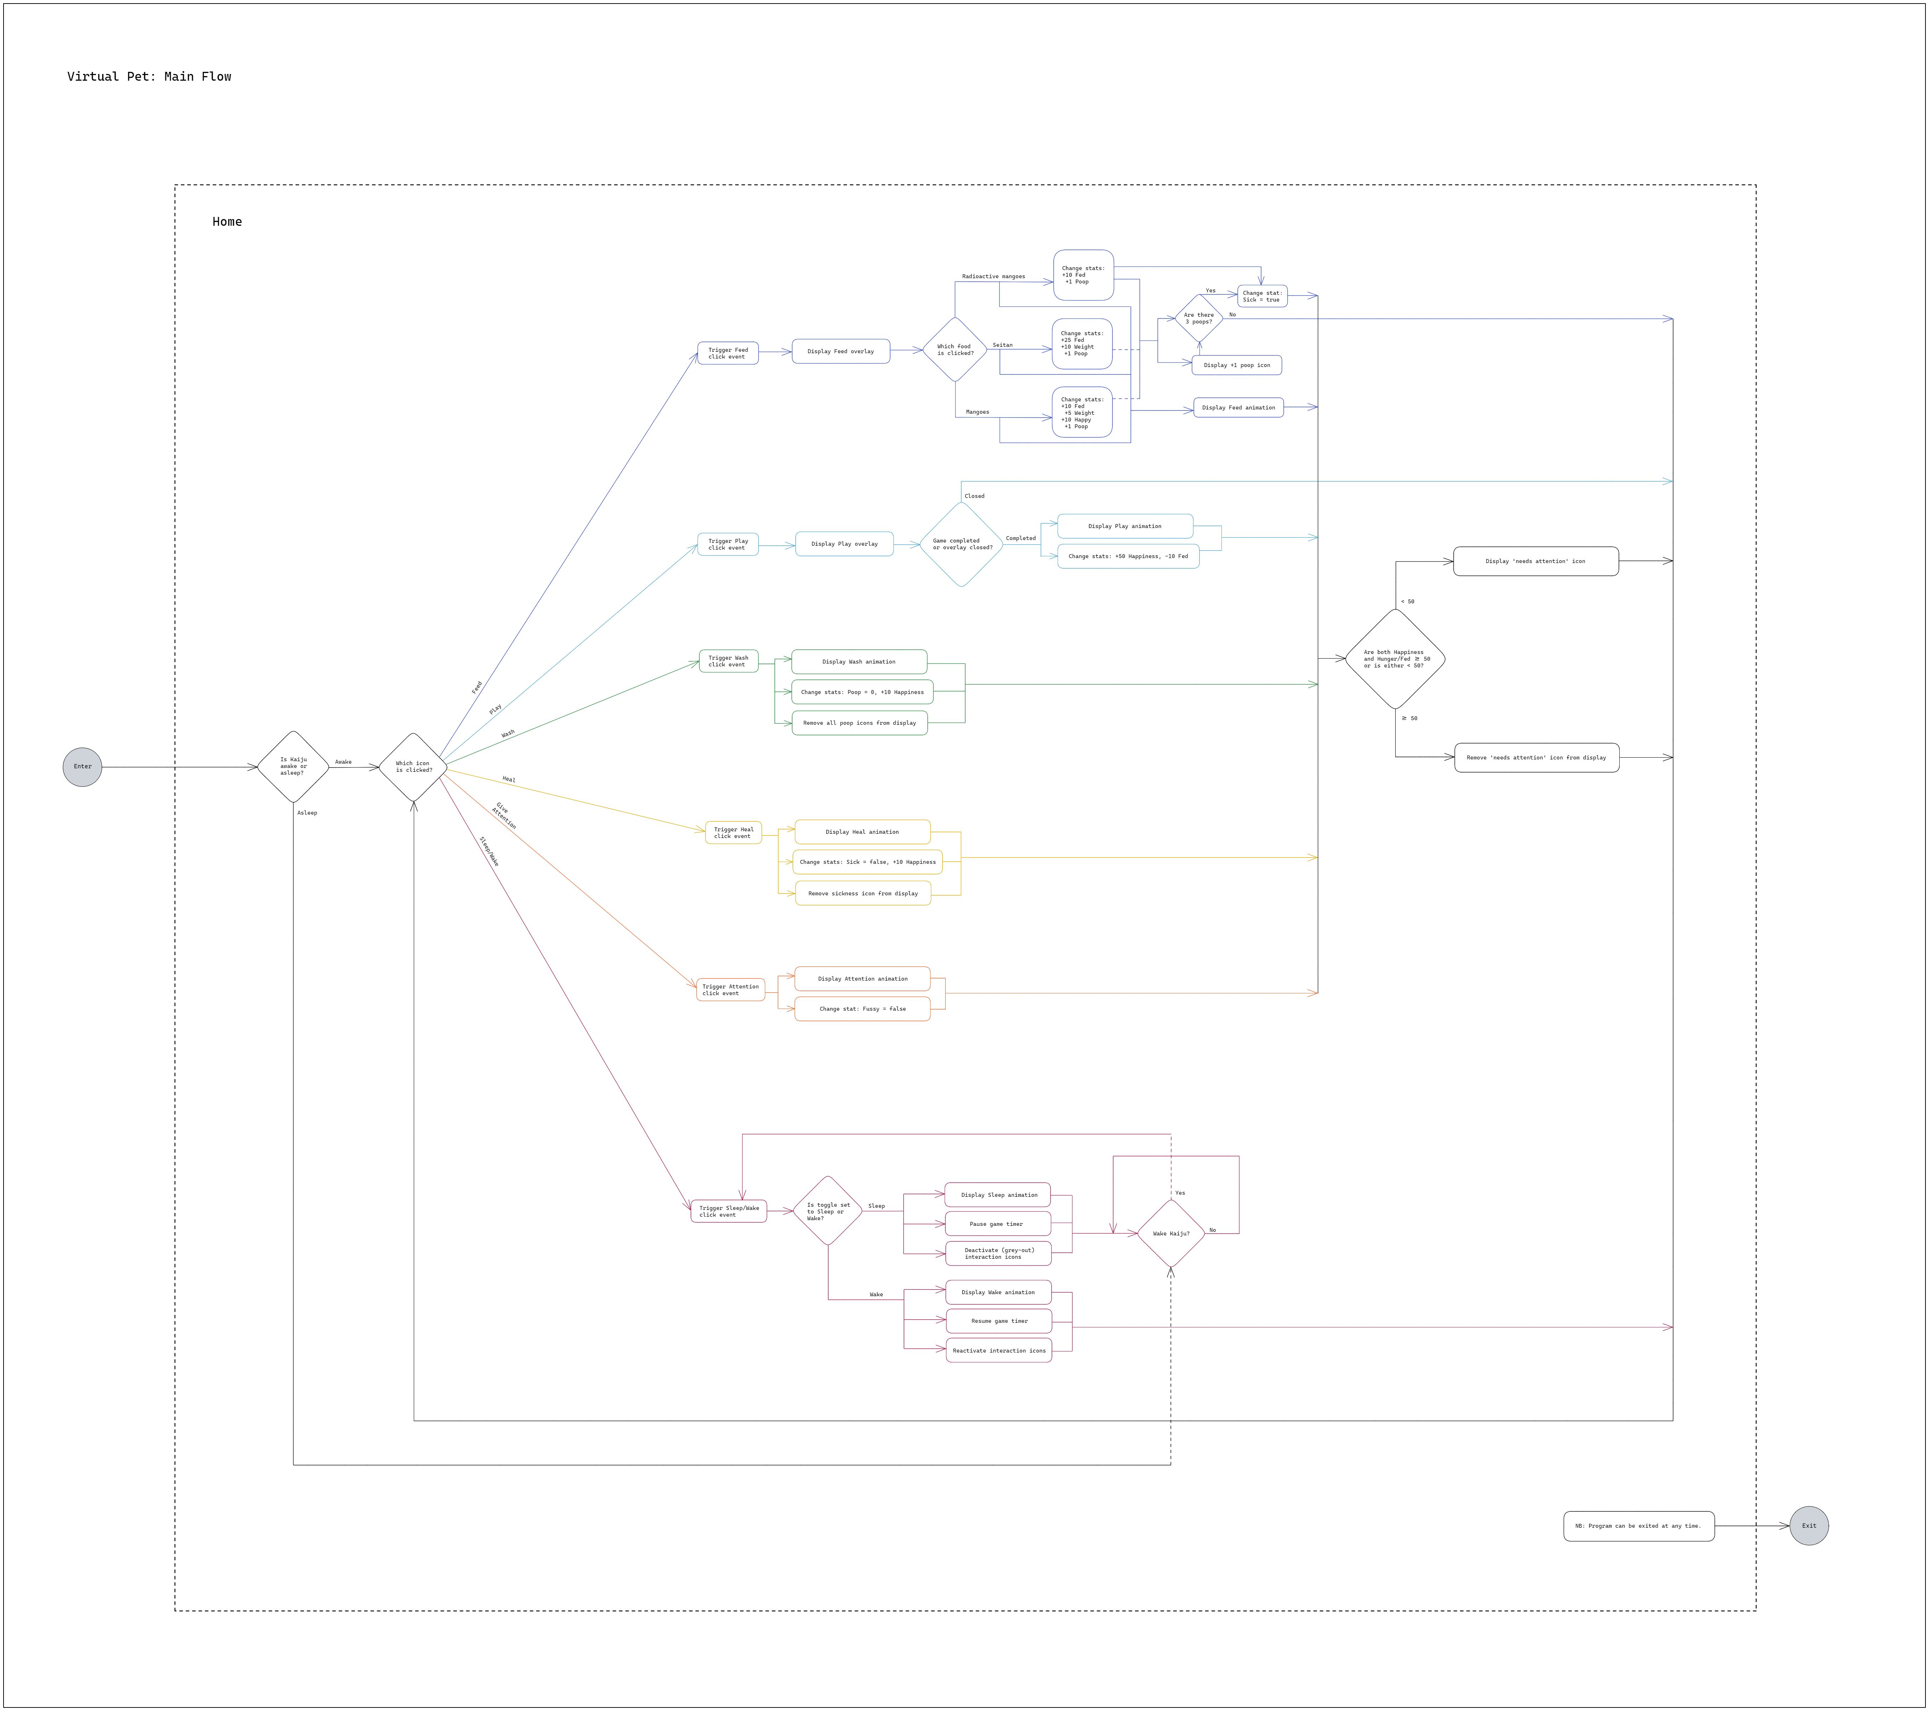

Rose Scoville Project Manager
Organized the project and ensured all team members had what they needed to do their respective work
Researched and set up the team's project management tools (Atlassian: Confluence, Jira), dynamic documentation (Project Board, Roadmap, Backlog), and source control for development (Atlassian: Bitbucket)
Co-wrote, did final edit on, and submitted all team deliverables
Co-wrote Developers' Manual and Quality Assurance Guide (Bitbucket)
Facilitated team retrospectives, helped facilitate communication between team members when needed
Gave team weekly updates on project status, updated Project Board and Roadmap
Created application User Flow
Researched minigame for application (to be developed if time)

Slide 10
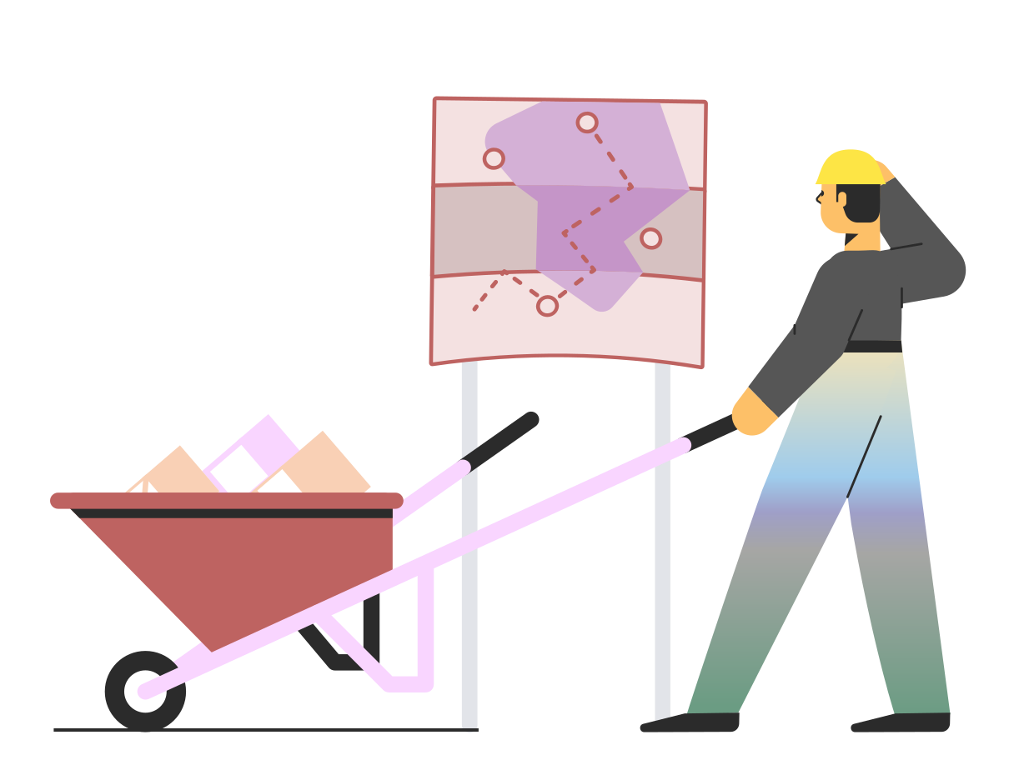
Process

Slide 11
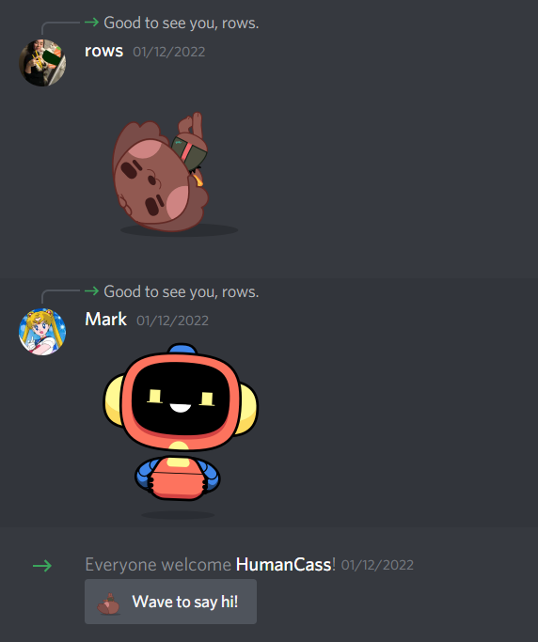
Where We Started
The team initially consisted of three members, full of excitement we quickly created a Discord server and started brainstorming project ideas. Shortly after, a fourth was added and she was caught up to speed and included in the brainstorming.
We landed on an idea inspired by Tamagotchi and Neopets that we had grown up with. At first, the idea was to create a more extensive web-based application combining the depth of Tamagotchi's pet care and the breadth of Neopets' web connectivity. We quickly decided that was an absurdly large scope and instead planned for a more realistically sized minimum viable product for our initial proposal, a standalone application with a very small website/database component.
After our initial proposal was submitted a fifth team member joined. We divvied the tasks, expanded the web element to reflect the newly added skills and interests, and reworked the Project Proposal.

Slide 12
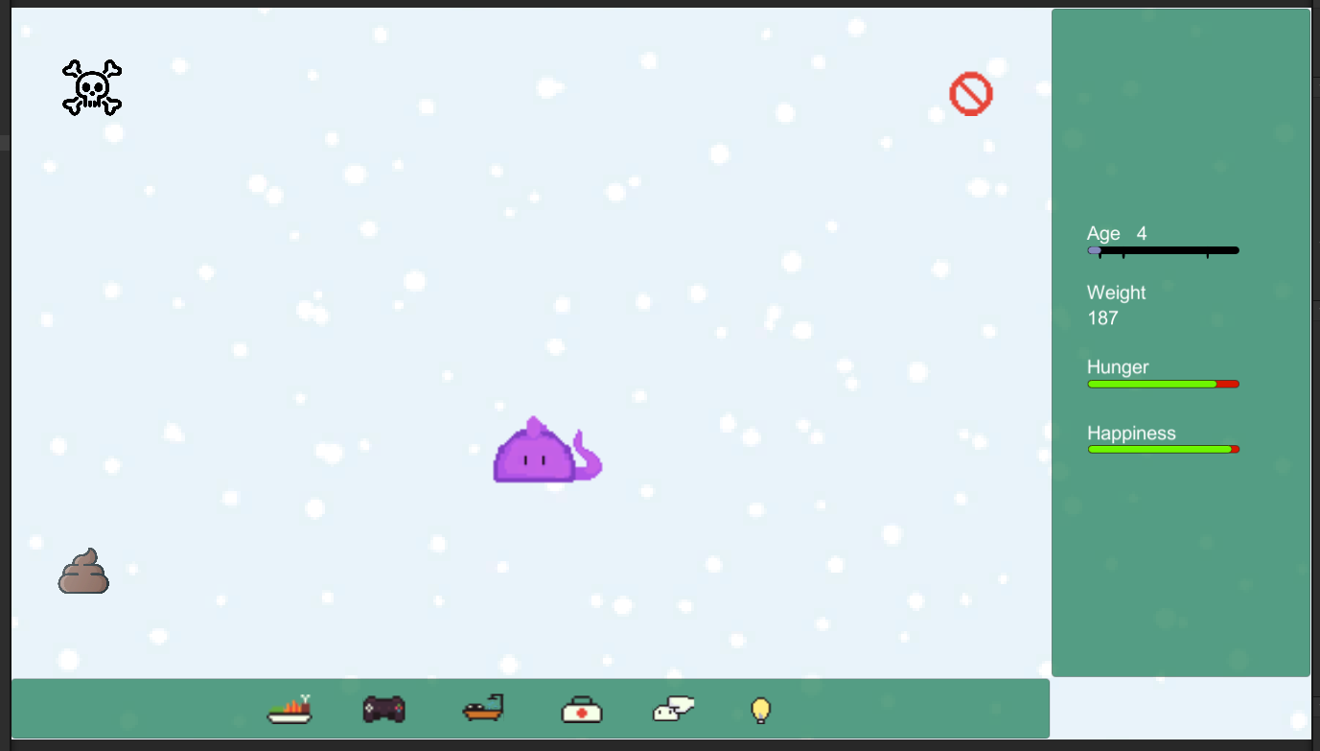
Where We Ended
Unfortunately, communication problems started affecting our work output in the final stages, and while we didn't quite finish all our objectives for the deliverable of Milestone 2, we continued to work after the fact and did complete most of them prior to the presentation deliverable.
We ended up with a virtual pet with all the care functionality implemented. While there are no minigames or high scores being tracked as was originally planned, we believe that given slightly more time and slightly better communication going forward, we would be fully able to complete what we set out to build.
Regardless, it was a great learning experience, and we're all quite proud of what we've worked as a team to create.

Slide 13

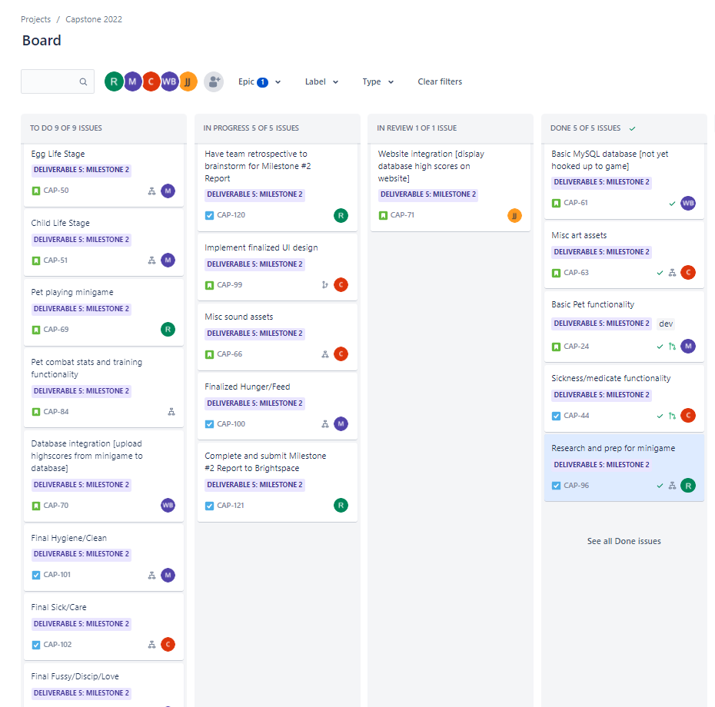
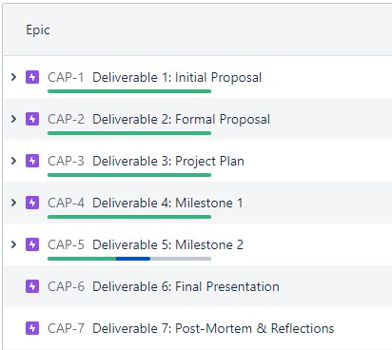
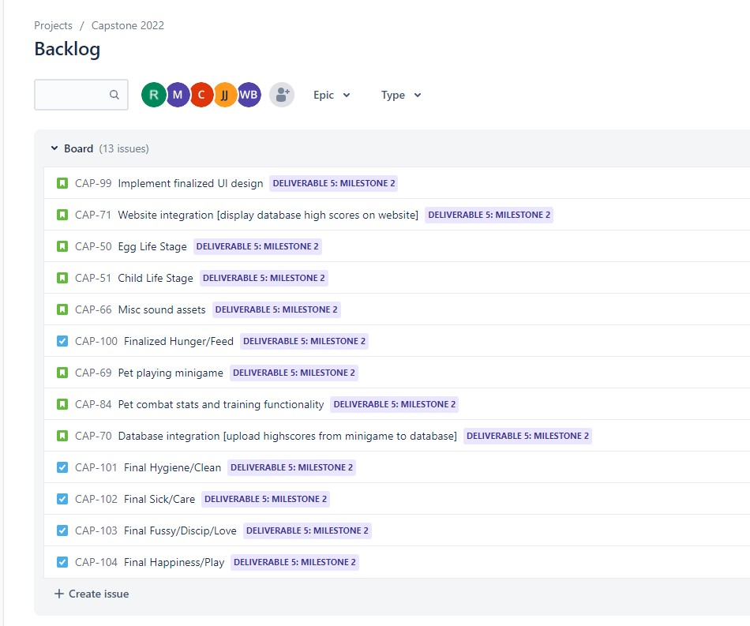
Methodology Kanban (Agile)
Kanban Board
Work for the current cycle was represented visually in Kanban style, with tasks collected within four columns: 'To Do', 'In Progress', 'In Review', and 'Done'.
Epics
The project was divided into epics (cycles) with each epic representing a deliverable milestone. As each milestone was met, the Kanban board was be reviewed and reset for the next cycle.
Tasks
The work required to meet that deliverable was divided into tasks and subtasks, represented as tickets on the Kanban board. These tasks displayed work description, assignee, deadline, dependencies, and linked to development branches within the project's source code.
Backlog
All the project's tasks were listed within a project backlog. This master list of future work functioned as a hopper that fed into the board at the beginning of each new cycle.

Slide 14

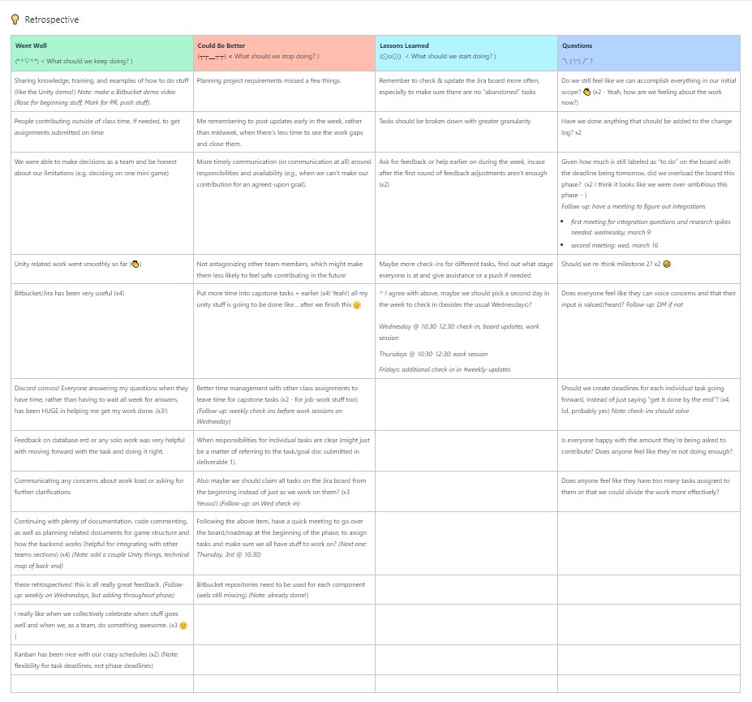
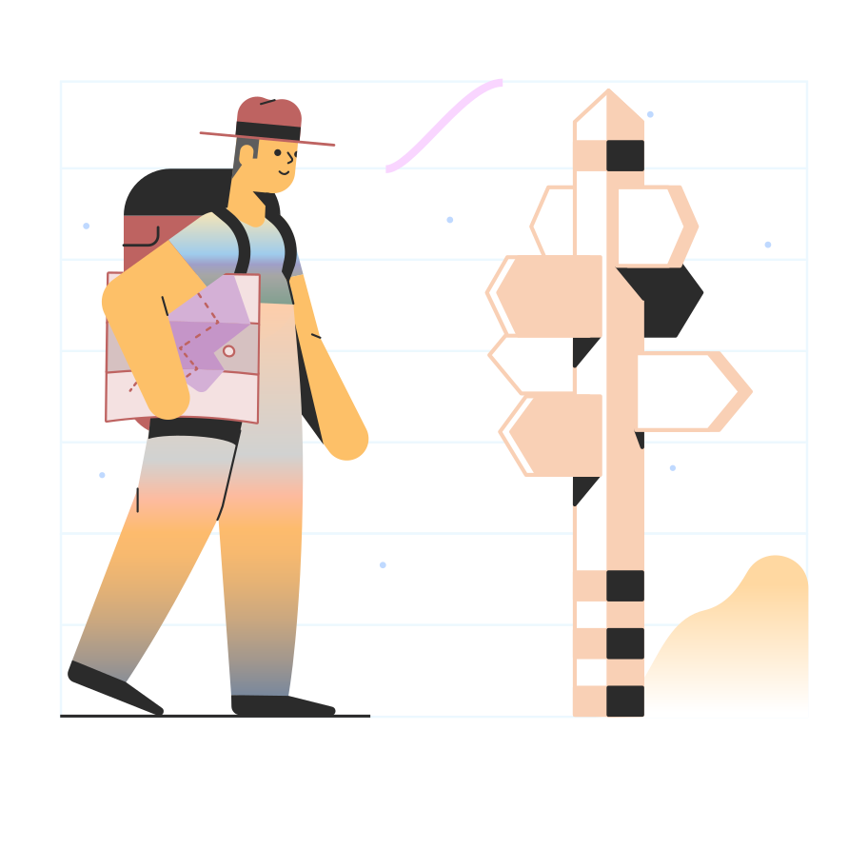
Reflections on Team Process
Retrospectives
The team held retrospectives at the end of each development phase to review the work done in that phase. We anonymously contributed to three categories: what went well (keep doing), what could have gone better (stop doing), and lessons learned (start doing). We also contributed any questions we had. After all learnings and questions were added, we discussed each item and made action items to improve the next phase.
Key Learnings and Take-aways
Frequent (twice a week) "stand-ups" or team member updates helps maintain a greater sense of connectivity and responsibility to the project and colleagues.
Individual communication and updates on one's own capacity to complete work is crucial for project group/project success, as work is highly interconnected.
Regular shared learning as project progresses is an effective, efficient tool for keeping all team members educated and working in tandem toward the same goals. Conversely, when members work in isolation, goals become muddled.
Retrospectives are helpful for identifying bottlenecks and roadblocks early. Follow-up implementation of team suggestions is equally important.

Slide 15


Documentation
The following documentation was used throughout the project's planning and execution.
Project Proposal
Project Plan
Project Roadmap (Gantt Chart)
Project Board (Kanban)
Project Backlog
Project Objectives Master List
Developers' Manual / Quality Assurance Guide
Game Design Document
Wire Flow
User Flow
Milestone Reports
Final Project Report
Team Reflections

Slide 16
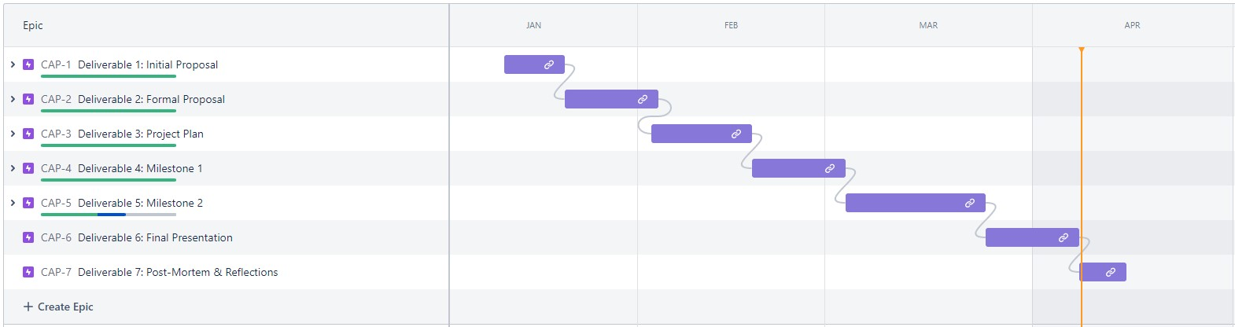
Documentation
Project Roadmap (Gantt Chart)

Slide 17
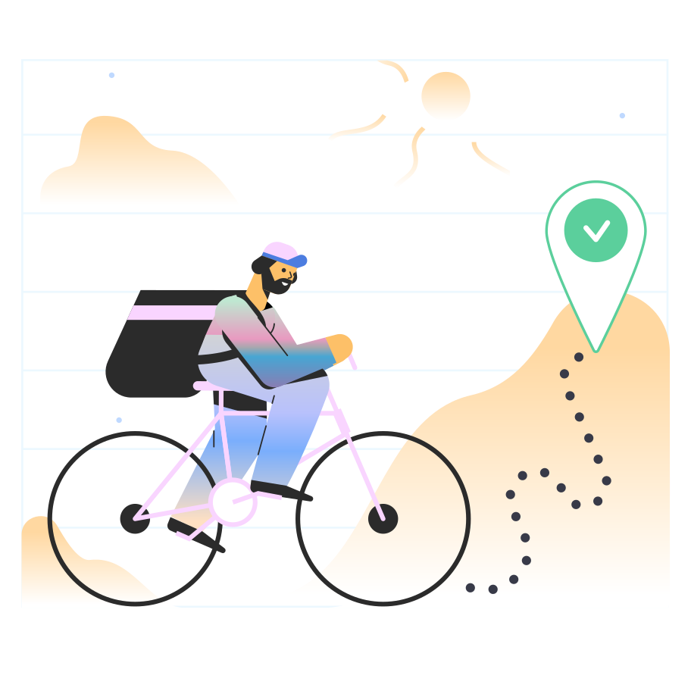
Documentation
User Flow

Slide 18
Documentation
Wire Flow

Slide 19
Documentation
Database ERD

Slide 20
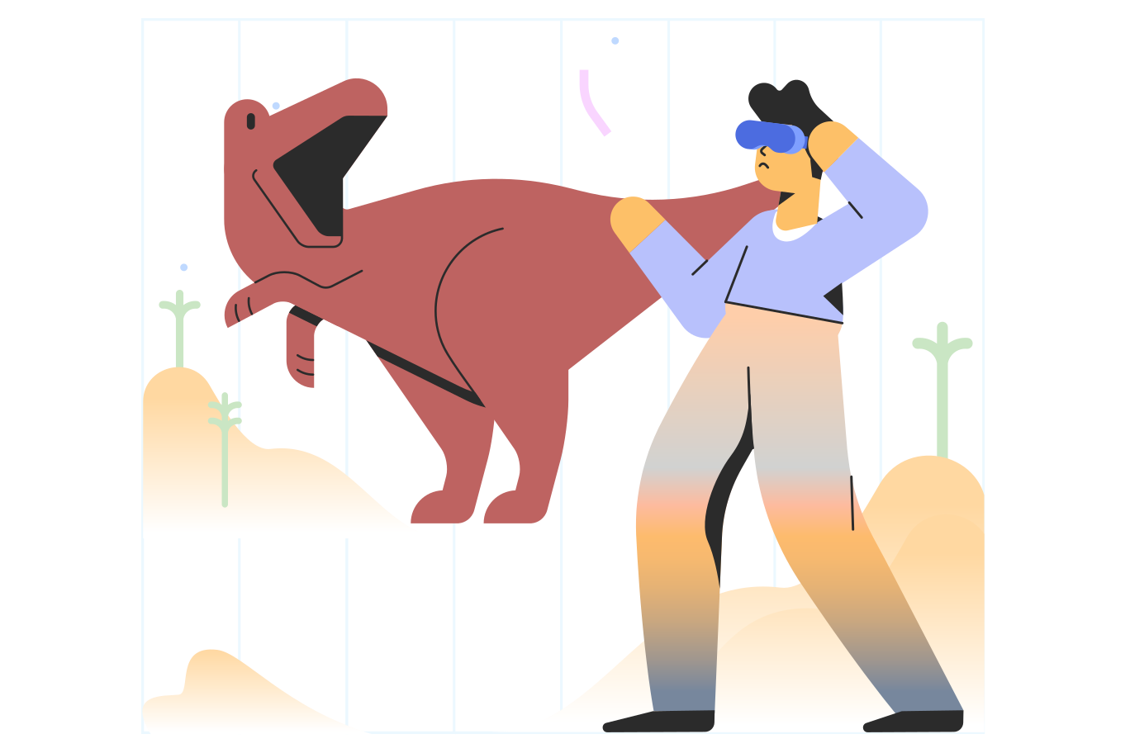
Project Demo

Slide 21
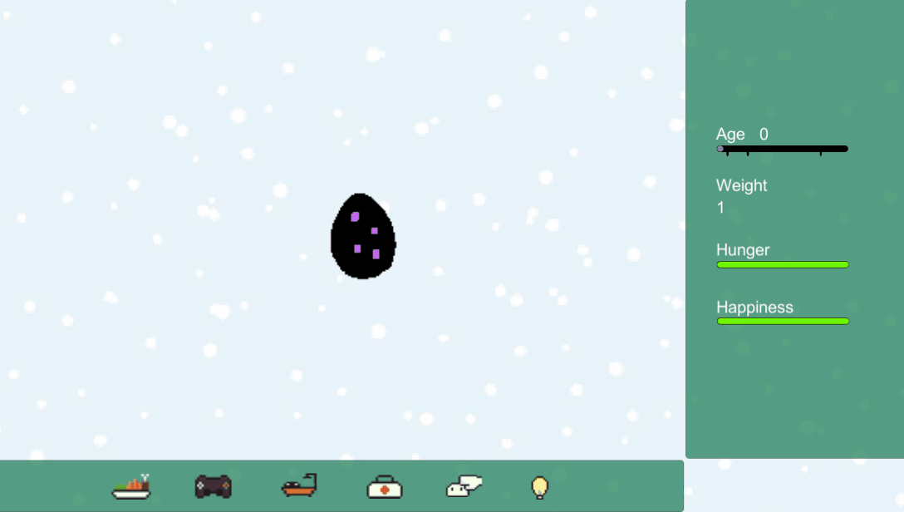
App Demo

Slide 22

Thanks for reading!
Authors:
Wiktoria Biernat, Cassandra Curtis, Mark Moulton, Rose Scoville
Illustrations from Ouch!a

